Slide 1
GAAP Training
How to prepare the GAAP forms
STATE OF CONNECTICUT
Annual
Comprehensive
Financial
Report
Fiscal Year Ended
June 30, 2025
Sean Scanlon
State Comptroller
2025

Slide 2
Annual Comprehensive Financial Report (ACFR)
The ACFR is prepared in accordance with Generally Accepted Auditing Principles (GAAP).
Simplistically, GAAP follows the accrual basis of accounting, while other State reporting is mostly cash basis.
The GAAP Package Forms provides OSC the information required to make GAAP adjustments for the ACFR.
Having GAAP-based financial statements is important for bonds and rating agencies.

Slide 3
Overview of OSC Requests
Standard forms package – GAAP Forms #1 thru #9 (beginning in FY26, to be submitted via online portal)
Questions and Communication direct to the OSC ACFR Teams Channel or Email OSC.ACFRReporting@ct.gov
The Standard forms with instructions, are available in EXCEL format via this hyperlink:
http://www.osc.ct.gov/agencies/forms/
******
The training materials are available at the same location using Power Point.

Slide 4
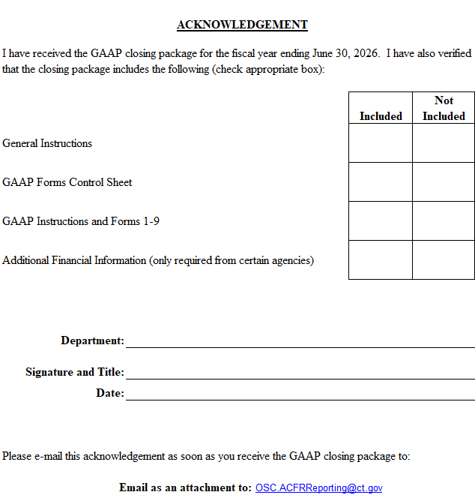




ACKNOWLEDGEMENT
My Agency
My Name and Title

Slide 5
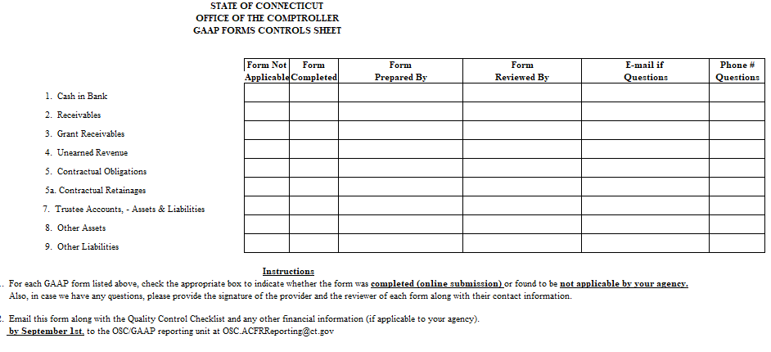
CONTROL SHEET

Slide 6
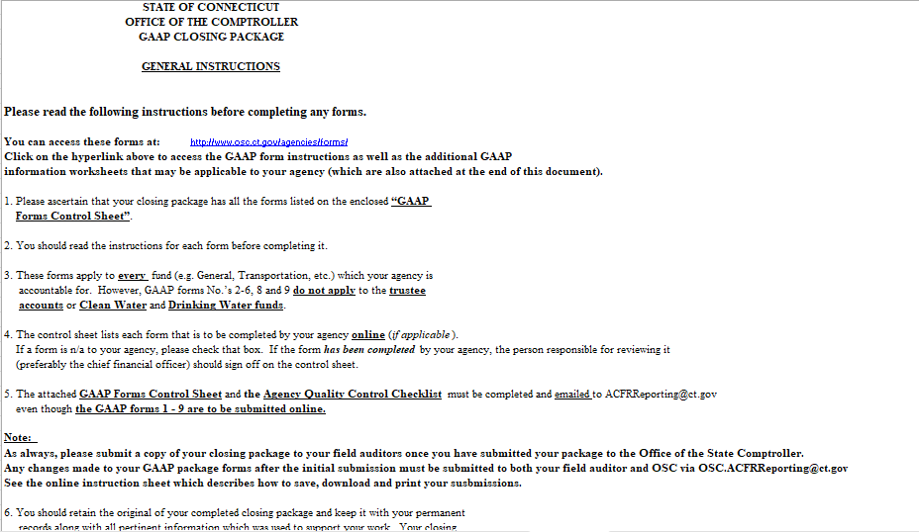
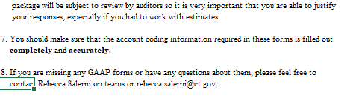
GENERAL INSTRUCTIONS

Slide 7
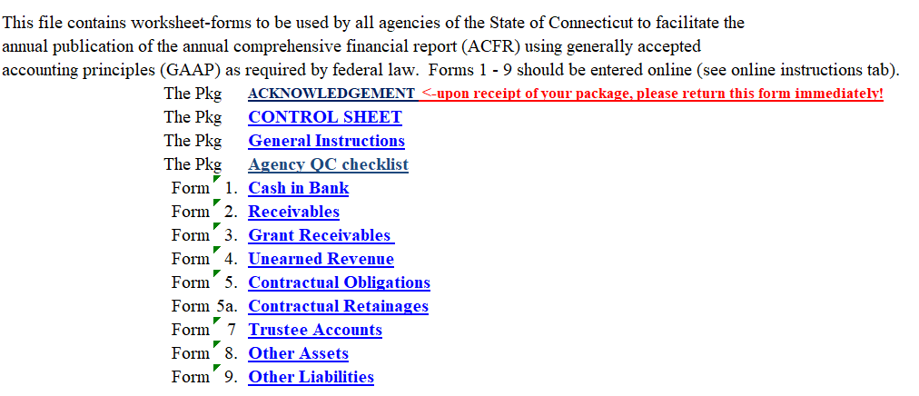
The GAAP Closing Package Standard Forms

Slide 8
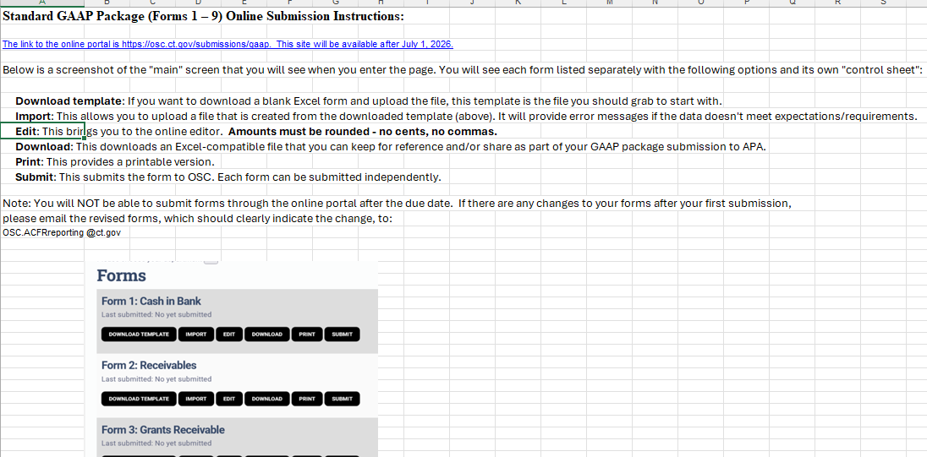
Online Submission Instructions

Slide 9
GAAP FORM # 1
Instructions for completing the form and
Case Examples for preparation of Standard GAAP forms

Slide 10
GAAP Closing Package
GAAP Form #1 – Cash in Bank
Bank Accounts not already in Core-CT
Including cash in custody of the agency, trustee bank accounts and any other bank accounts not included in Core-CT
Provide summary information only (details are not required) concerning the balances as requested on the form.

Slide 11
GAAP Form #1 Cash in Bank
For purposes of this form, "cash in bank" is defined as bank accounts which are in the custody of your agency and are not reported in CORE-CT as of June 30th. For example, non-Core checking accounts, certificates of deposit, etc.
This form does not apply to petty cash or STIF accounts. Because this cash is either recorded in Core-CT and/or reported by way of the State Treasurer's Office
If your agency does not have any Non-Core bank accounts to report, please check “form not applicable” on GAAP Forms Control Sheet.
Continued

Slide 12
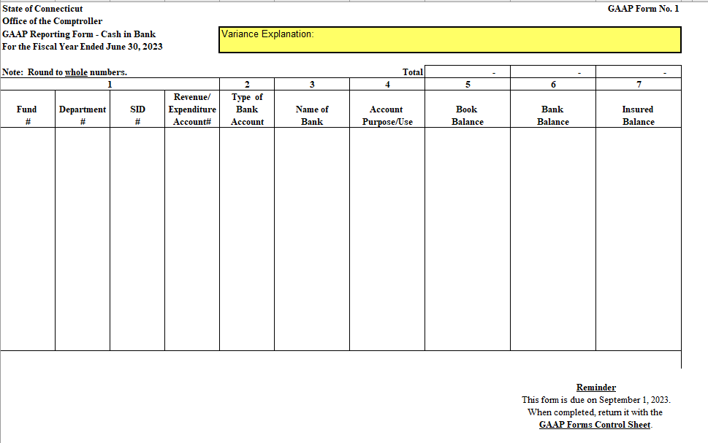
Form #1-Cash In Bank

Slide 13
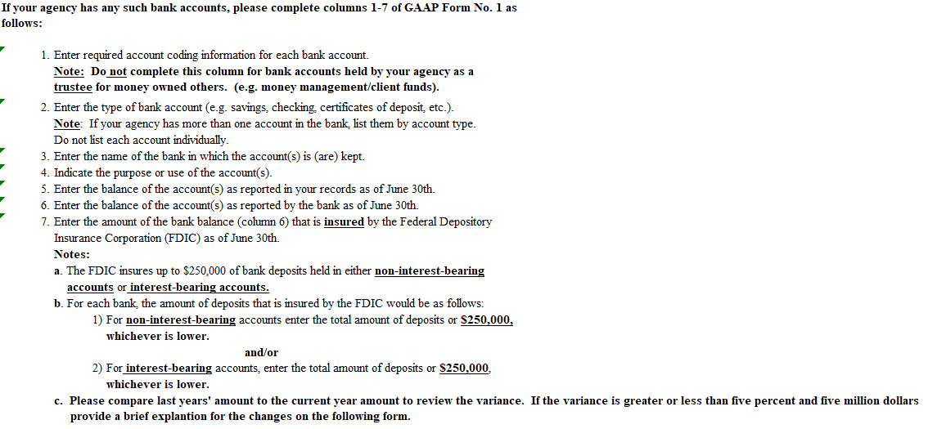
Instructions for-GAAP Form No. 1

Slide 14
Instructions GAAP Form #1
Do not include cash accounts already recorded on the State General ledger

Slide 15
GAAP Form Training
GAAP Form #1 Cash in bank
Examples/Cases
On June 30, 2026, your agency had $85,000 in a CD, $105,000 in savings and $30,000 in checking at the ABC Bank. None of these bank accounts are reported in Core-CT. Your records show $85,000 in a CD, $95,000 in savings and $28,000 in checking. All monies in the checking account represent unexpended funding provided by the State general fund. The monies in the savings and CD represent “rep payee”, “money management” and “client funds”.
Your agency has a savings and checking account at the First Bank. Neither of these bank accounts are reported in Core-CT. On June 30, 2026, your agency had $130,000 in savings and $5,000 in checking. All monies in the accounts represent seized evidence pending distribution per court order. Your records show $100,000 in savings and $4,500 in checking. All monies will be paid from fund 34003, Funds Awaiting Distribution, in the following fiscal year.

Slide 16
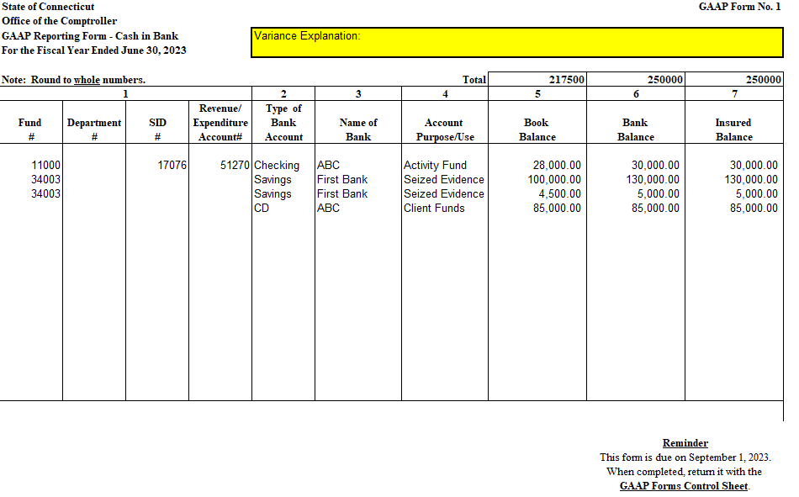
GAAP form #1 Example

Slide 17
GAAP FORM # 2
Instructions for completing the form and
Case Examples for preparation of Standard GAAP forms

Slide 18
GAAP Closing Package
GAAP Form #2 Receivables
Accounts receivable from ordinary business in trade
Claims receivable

Slide 19
GAAP Form #2 Receivables
For purposes of this form, receivables are defined as amounts owed to the State of Connecticut by individuals, private organizations, or other State or local governments as of June 30th for:
a. Goods or services provided to individuals, private organizations, or other State or local governments on or prior to June 30th, or
b. Other claims against individuals, private organizations, or other State or local governments which arose on or prior to June 30th.
If your agency has no receivables to report or if the total amount of receivables to be reported in column 4 is less than $300,000, please check “form not applicable” on GAAP Form Control Sheet.

Slide 20
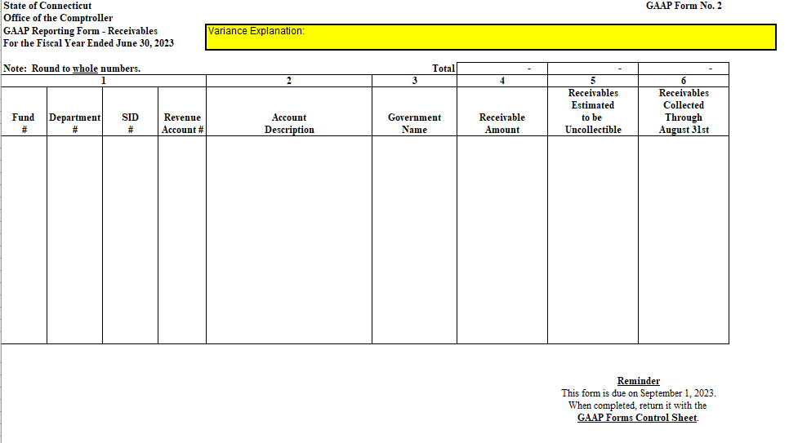
GAAP Form # 2 Receivables

Slide 21
Instructions – GAAP Form #2
Do not report on this form the following types of receivables:
Grants or contributions due from the federal or private providers (see GAAP Form No. 3).
Loans receivable (OSC gets this via official letter).
Fees receivable for licenses, permits, or certificates.
Amounts due from other State of CT agencies.

Slide 22
Instructions – GAAP Form #2
If the total amount of receivables to be reported in column 4 is greater than or equal to $300,000,
please complete columns 1-6 of GAAP Form No. 2 as follows:
Enter required account coding information for each receivable amount in column 4.
Enter a description of the receivable to be collected.
Enter the name of the debtor government, if applicable.
Enter the amount of the receivable as of June 30th.
Include in this amount any receivables that are held for collection by the Department of Administrative Services and/or the Office of the Attorney General.
If your agency administers federal grant programs on behalf of municipalities or other third parties and if as of June 30th there were disallowed expenditures or unexpended balances related to those programs that needed to be refunded to the federal government, report a receivable for the refund owed by the municipality or other party on this form and a liability for the portion of the refund that must be returned to the federal government on GAAP form No 9 (other liabilities).
Enter the portion of the amount of the receivable in column 4 that your agency has estimated to be uncollectible as of June 30th . Note: Use your best estimate. It is your responsibility to determine the quality of the receivable and, thus, report an amount that may ultimately not be collectible.
Enter the portion of the amount of the receivable in column 4 that, as of the fiscal year ending June 30th, was collected by your agency on or before August 31, of the next fiscal year.
Please compare last years’ amount to the current year amount to review the variance. If the variance is greater or less than five percent and five million dollars proved a brief explanation for the changes on the following form.

Slide 23
GAAP Form Training
GAAP Form #2 Receivables
Examples/Cases
On April 1, 2026, your agency billed A Corporation $285,000 for services rendered. On June 1, 2026, based on prior experience, you determine that you will collect a total of $245,000 on the original $85,000 invoice. On August 1, 2026, you received $45,000 from Y Corporation and recorded it under fund number 12001, SID 18010, Department number DOT57111 and revenue account number 44014.
On May 20, 2026, your agency billed B Corporation $25,000 for services rendered. As of June 30, 2026, no monies had been received from Z Corporation. On July 21, 2026, you received $25,000 from Z Corporation and recorded it under fund number 11000, Department number DPS32110 and revenue account number 44070.
On May 15, 2026, your agency billed various individuals $95,000 for driver license renewals. The fees were due on June 15, 2026, and the licenses will expire on May 15, 2026, your agency had collected $65,000 of these fees as of June 30, 2026.
On August 1, 2026, your agency determined that Oldtown, CT had spent $30,000 during fiscal year ending June 30, 2026, of a $55,000 State grant which is administered by your agency. The total amount of the grant was advanced to the town on July 15, 2026. The grant contract specified that any unexpended grant balance at June 30, 2026, was to be returned to the State. This grant balance was collected by your agency on August 20, 2026, and was recorded under fund number 13010, Department number SDE64060 SID 40901 and to account 55050 as a return of unexpended grant balances.
On May 5, 2026, your agency billed another State agency $20,000 for services rendered. As of June 30, 2026, your agency had not received payment from the other State agency. When collected, this revenue will be recorded under fund number 22003, department number DPS32110 and revenue account number 44070.

Slide 24
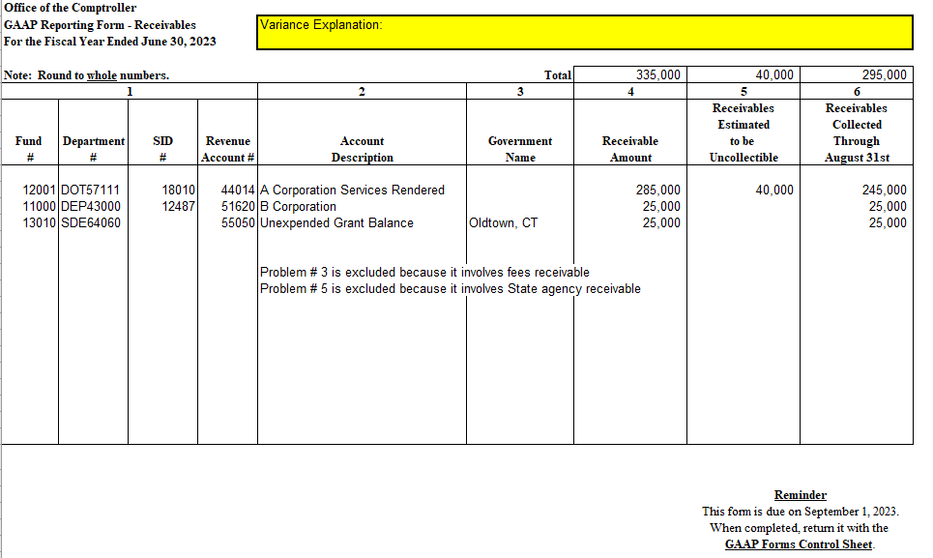
GAAP Form # 2-Example

Slide 25
GAAP FORM # 3
Instructions for completing the form and
Case Examples for preparation of Standard GAAP forms

Slide 26
GAAP Form #3 Grants Receivable
For reimbursement of State expenditures or
When State expenditures are Funded in Advance
[See closing package instructions for GAAP form #3 concerning “other than reimbursement” grants]

Slide 27
GAAP form #3 Grants Receivable
For purposes of this form, grants receivable are defined as grant (or other financial assistance) amounts owed to the State of CT by the federal government (provider) as of June 30th.
However, this form also applies to those rare cases in which the provider of a grant or contribution, is an individual or a private organization.
If your agency has no grants receivable to report or if the total amount of grants receivable to be reported in column 4 is less than $300,000, please check “form not applicable” on the GAAP Form Control Sheet.

Slide 28
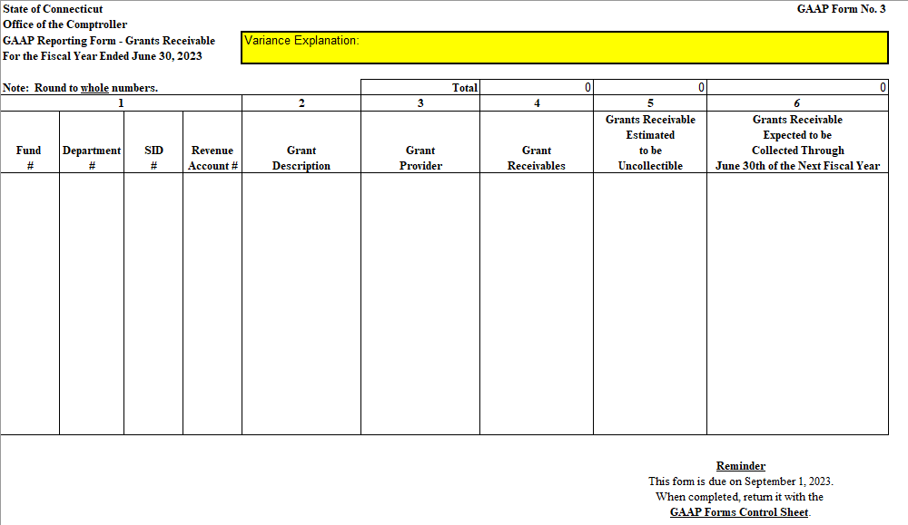
GAAP Form # 3 Grants Receivable

Slide 29
Instructions – GAAP Form #3
Do not report on this form grant activities that are reimbursed by another State of CT agency. Generally, Receivables for “pass-thru” grants are reported by the “drawdown” agency

Slide 30
Instructions for GAAP form #3
GAAP requires grants receivable to be reported when all applicable eligibility requirements, including time requirements, established by the provider have been met.
Eligibility requirements
comprise one or more of the following (as applicable):
Required characteristics of recipients. The recipient (and secondary recipient, if applicable) has the characteristics specified by the provider. For example, under a certain federal program, recipients are required to be states and secondary recipients are required to be school districts.
Time requirements. The period specified by the provider when grant resources must be spent by the State.
Reimbursements. The provider stipulates that the State cannot qualify for resources without first incurring allowable expenditures under the provider’s program.
Contingencies. The provider’s offer of resources may be contingent upon a specific action by the State or a required performance outcome. For example, the State may be required to demonstrate its affirmative action employment practices or to spend a specific percentage of its own resources for the purpose specified in the grant documents i.e. matching requirement which, if not maximized by the State, may result in a portion of the original grant award being uncollectable.
Note: Contingencies should not be confused with purpose restrictions.
Purpose restrictions specify the purpose(s) for which the grant resources are required to be used. For example, a requirement that grant resources be used for street and road repairs is a purpose restriction, not a contingency.

Slide 31
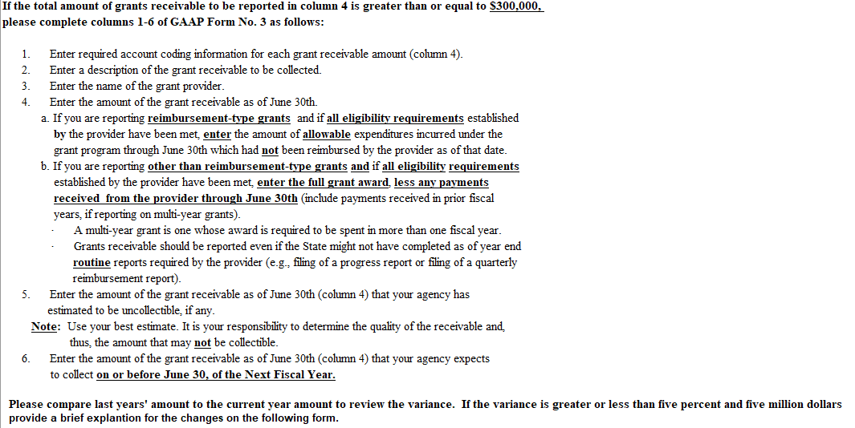
Instructions for GAAP form #3

Slide 32
Notes: Column six Collected amount
Why would GAAP form #3 ask agencies for the amount to be collected in the next twelve month period rather than the amount “available” that would normally be collected in the two month period following the end of the fiscal year?
The date on Column 6 should be completed as follows per GASB 33 revenue recognition criteria,
For reimbursement type Grants Receivable, the correct column six amount would be the “available” amount, being represented by grant receipts in the two-month period following the end of the fiscal year.
For NON-reimbursement type Grants Receivable, the correct column six amount would be the full amount of the grant award less current and prior year provider payments received, if any, on the grant.
Please review GASB 33 guidance on revenue recognition in the following slides

Slide 33
GASB Statement No. 33 paragraphs 24 and 30d
Revenue Recognition in Governmental Fund Statements
When financial statements for governmental funds are presented using the current financial resources measurement focus and the modified accrual basis of accounting, revenues from non-exchange transactions should be recognized “in the accounting period when they become measurable and available.
*****************************
When the modified accrual basis of accounting is used, revenues resulting from non-exchange transactions should be recognized as follows:
Derived tax revenues. Recipients should recognize revenues in the period when the underlying exchange transaction has occurred and the resources are available.
Imposed non-exchange revenues—property taxes. Recipients should recognize revenues in accordance with Section P70.
Imposed non-exchange revenues—other than property taxes. Recipients should recognize revenues in the period when an enforceable legal claim has happened and the resources are available.
Government-mandated non-exchange transactions and voluntary non-exchange transactions. Recipients should recognize revenues in the period when all applicable eligibility requirements have been met and the resources are available.
Sometimes a provider in a government-mandated or voluntary non-exchange transaction does not specify time requirements. When that is the case, the entire award should be recognized as a liability and an expense by the provider, and as a receivable and a revenue (net of estimated uncollectible amounts) by the recipients, in the period when all applicable eligibility requirements are met (applicable period).

Slide 34
GASB Statement No. 33 paragraph 24
When the provider is a government (including the federal government), the applicable period for both the provider and the recipients is the provider’s fiscal year and begins on the first day of that year (when, for example, the relevant appropriation becomes effective). If the Grant is advance funded the entire award should be recognized at that time.
However, if a provider government has a biennial budgetary process, each year of the biennium should be considered a separate applicable period. In those circumstances, the provider and the recipients should allocate one-half of the resources appropriated for the biennium to each applicable period, unless the provider specifies a different allocation.

Slide 35
GAAP Form Training
GAAP form #3 Grants Receivable
Examples/Cases
On June 30, 2026, your agency had a reimbursement grant from the federal government. The grant period is from 10/1/20 thru 9/30/26 as the providing federal agency’s award specified. At 6/30/26 grant expenditures incurred by the State were $1,000,000. The amount of reimbursements received from the Federal Agency as of 6/30/26 was $800,000. The grant revenue will be recorded under fund 12060, department DSS60110, account 45020 under various SIDs. What will be your grant receivable amount at 6/30/26?
Using the same dollar facts as above, except the grant revenue will be recorded under 11000-DCF91111-18010-45260
On June 30, 2026, your agency had a non-reimbursement grant from the federal government. The grant period is from 10/1/21 thru 9/30/26 as specified by the provider. The original grant award was for $5,000,000. At June 30, 2026, grant expenditures incurred by the State were $3,000,000. The amount of payments received from the provider as of June 30, 2026 totaled $4,000,000. On July 15, 2026, an additional $1,000,000 was received from the provider. The grant revenue will be recorded under 12062-DOT57111 -22274-45020. What will be your grant receivable amount at 6/30/26?
On June 30, 2026, your agency had a non-reimbursement grant from A Corporation. The grant period is from 10/1/21 thru 9/30/26 as specified by the provider. The original grant award was for $6,000,000. At June 30, grant expenditures incurred by the State were $2,000,000. The amount of payments received from the provider was $3,000,000. Your agency estimated that uncollectible grant receivables would be $150,000. The grant revenue will be recorded under 12060-DSS60000-18010-45500. What will be your grant receivable amount at 6/30/26?
On June 30, 2026, your agency had a non-reimbursement federal grant. The grant period is from 10/1/20 thru 9/30/26 as specified by the provider. The original grant award was for $3,000,000 which must be spent evenly over the grant period 1/3 each fiscal year. At June 30, grant expenditures incurred by the State were $550,000. The amount of payments received from the provider as of 6/30/26 were $750,000. Your agency estimated that uncollectible grant receivables would be $0. Grant receivables collected through 8/31/26 were $50,000. The grant revenue will be recorded under 12060-DSS60000-18010-45020. What will be your grant receivable amount at 6/30/26?

Slide 36
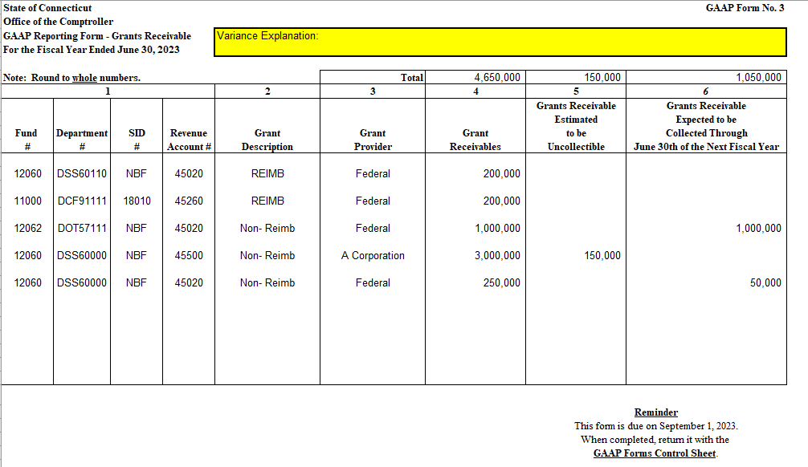
GAAP Form #3 - Example

Slide 37
Notes: Column four Grants Receivable Amount
Reimbursement-type grants (including drawdown-type grants), if all eligibility requirements established by the provider have been met enter allowable expenditures which were incurred under the grant program through June 30 & which had not been reimbursed by the provider as of that date. Cases 1&2
Other than reimbursement-type grants (single-year grants only), if all eligibility requirements established by the provider have been met enter full grant award, less any payments received from the provider through June 30. Case3
Multiyear grants only and if provider did not specify time requirements and if all other eligibility requirements established by the provider have been met, enter the full grant award, less any payments received from the provider through June 30. case 4
Other than reimbursement-type grants if all eligibility requirements established by the provider have been met enter the portion of the grant award that, according to provider's time requirements should have been spent during the current fiscal year, less any payments received from the provider through June 30. Case 5

Slide 38
GAAP Form #3 Calculation for Grants Receivable
Reimbursement-Type Grant (Note A)
Allowed Grant Expenditure
$
1,000,000
Less: Reimbursements as of June 30, 2026
800,000
Grant Receivable
$
200,000

Slide 39
GAAP Form #3 Calculation for Grants Receivable
Non-reimbursement Grant (Note B)
Original Grant Award
$
5,000,000
Less: Payments received from provider June 30, 2026
4,000,000
Grant Receivable
$
1,000,000

Slide 40
GAAP Form #3 Calculation for Grants Receivable

Slide 41
GAAP Form #3 Calculation for Grants Receivable

Slide 42
GAAP FORM # 4
Instructions for completing the form and
Case Examples for preparation of Standard GAAP forms

Slide 43
GAAP Closing Package
GAAP form #4 unearned Revenue
Advances

Slide 44
GAAP Form #4 Unearned Revenue
Unearned revenue is defined as cash collected by the State from regulatory assessments imposed on individuals or private organizations on or prior to June 30th for services to be performed by the State after June 30th.
Unearned revenue results from cash receipts occurring in advance of the time period when the resources are required to be used as defined by enabling legislation pertaining to insurance, banking and other industry regulatory assessments.
These “advanced assessments” are required to be used the following fiscal year to fund State regulatory examinations and/or evaluations.

Slide 45
Instructions for GAAP form #4
Do not report on this form fees collected in advance for licenses, permits, or certificates.

Slide 46
Instructions for GAAP form #4
If the total amount of unearned revenues to be reported in column 3 is greater than or equal to $300,000, please complete columns 1-3 of GAAP Form No. 4 as follows:
1. Enter required account coding information for each unearned revenue amount (column 3).
2. Enter a description of the unearned revenue.
3. Enter the amount of the unearned revenue as of June 30th.
If your agency has no unearned revenue to report or if the total amount of unearned revenues to be reported in column 3 is less than $300,000, please check “form not applicable” on the GAAP Form Control Sheet.
Please compare last years’ amount to the current year amount to review the variance. If the variance is greater or less than five percent and five million dollars proved a brief explanation for the changes on the following form.

Slide 47
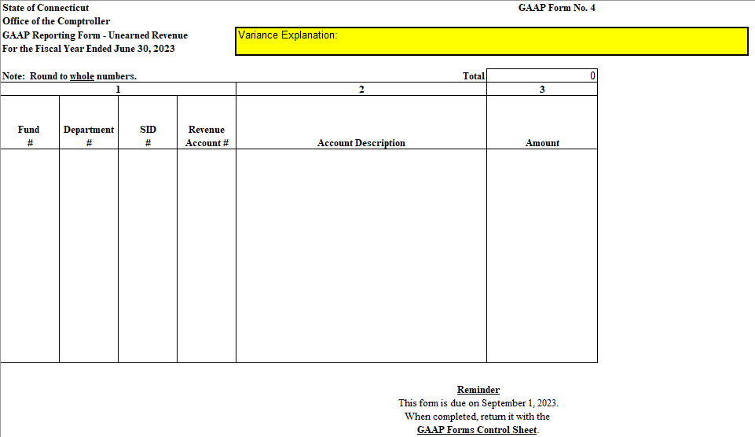
GAAP form #4

Slide 48
GAAP Form Training
GAAP form #4 Unearned Revenue
Examples/Cases
On June 1, 2026, your agency received $105,000 from K Corporation for the rental of a State building and recorded it under fund number 12001, Department number DOT57111, SID 18101 and revenue account number 44087. K Corporation will use the building for in-house training during the month of September 2026.
On June 10, 2026, your agency collected $150,000 from various companies for permits to transport merchandise across the State. The permits are valid for 2 years.
On September 1, 2024, the federal government awarded a $2,000,000 grant to your agency. The grant period is from 10-1-24 thru 9-30-26 as specified by the provider. The grant award was advanced by the provider on 10-1-24 as the State had satisfied all of the eligibility requirements by that time. The funds were provided with the stipulation that it should be spent in equal amounts over the grant period. The advanced funds were recorded under 12004-DOI37500-18010-44335

Slide 49
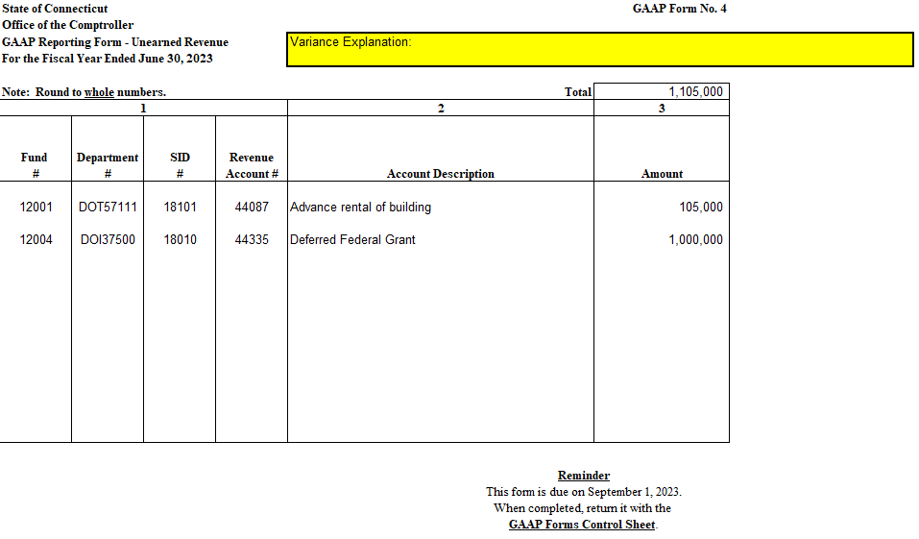
GAAP Form #4 Example
Case #2 is excluded because it involves licenses, permits and fees

Slide 50
GAAP Form #4 Calculation of Unearned Revenue
Grant monies received in advance
from provider
$
2,000,000
Less: Grant monies required to be spent
during current fiscal year
1,000,000
Deferred Revenue 6-30-26
$
1,000,000
(Amount required to be spent
next fiscal year)

Slide 51
GAAP FORM # 5
Instructions for completing the form and
Case Examples for preparation of Standard GAAP forms

Slide 52
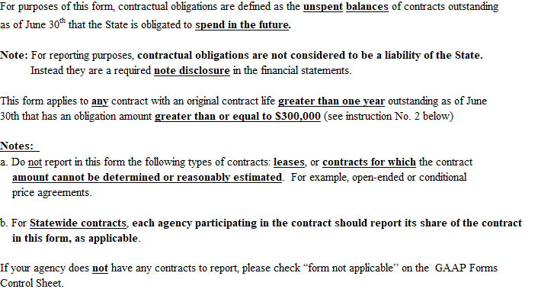
GAAP form #5-Contractual Obligations

Slide 53
Why Contractual Obligations?
When no liabilities have yet been incurred!!!
For a required footnote only
per NCGA interpretation 6 paragraph 4 and GASB Statement No.1
For what purpose?
Required for Bond Buyer capital debt analysis
To facilitate maximum bond issuer/taxpayer stress analysis

Slide 54
Added Instruction for GAAP form 5
Reporting Contractual Obligations – All agency contracts
For ACFR reporting of Contractual Obligations using GAAP form #5, State agencies must determine their unspent/unexpended balances on long-term contracts that remain outstanding and in effect at the end of the fiscal year that represent agreements that are expected to obligate the State to spending money for goods and services to be provided/performed in the future. NCGA Interpretation 6, paragraph 4, requires the State to disclose such so-called “significant commitments” in the notes to its financial statements.
Examples of such commitments include unexpended balances on multi-year purchase orders, multi-year contracts and statutory commitments as defined by annual public acts of the legislature that are outstanding at year end containing a certainty of identifiable future payments for goods and services that are expected to be provided/performed after June 30th such as multi-year contracts for non-employee personal service, construction, software maintenance and (debt related) financial advisors, having amendments effective prior to year end. (Please exclude investment advisor contracts as such commitments pertain to the management of funds reported as being apart from the primary government).

Slide 55
Added Instruction for GAAP form 5
Reporting Contractual Obligations – Statewide contracts
For purposes of the State of Connecticut’s GAAP form #5, the phrase “statewide contract” refers to a contract in effect at year end that was originated by a single agency (Smart agency) but is administrated by multiple agencies (Administrative agencies) participating in the State’s recognition of potential liabilities likely to occur in future years under such existing statewide contracts.
In the statewide contract situation, the Administrative agency is in the best position to report its future obligations and justify the need to exclude contracts where the contract amount cannot be determined. To facilitate reporting of statewide contracts, the Smart agency may need to communicate with multiple Administrative agencies if there are any restrictions such as limitations on a participating agency’s allocation on a particular contract.
It is best for the Administrative agency to exclude contracts where the amount is not determinable rather than making extra-ordinary efforts to estimate such amounts.

Slide 56
Added Instruction for GAAP form 5
GAAP forms #5 requirements for reporting contractual obligation amounts over $300,000 include;
The contract with a vendor/contractor must be in effect as of the end of the fiscal year.
The contract amount must be determinable. Therefore, exclude arrangements that are conditional as to the States’ obligation to a particular vendor. For example an arrangement may stipulate “if we buy from you, we will take a 50% discount because of our annual volume…” or “If we engage your services our commitment is not to exceed”… It is best for the State to exclude contracts where the amount is not determinable rather than making extra-ordinary efforts to estimate such amounts. On the other hand, information useful in making the determination of the contract amount may be included with encumbrance transactions that can be drawn initially from Core-CT or by visiting the legislative management or OFA’s website for public acts initiated in the prior year that effect the fiscal year being reported on.
The contract in effect at year end must be a multi-year contract so that there is no doubt that the obligations are NOT represented as liabilities on the financial statements as of the end of the fiscal year. Therefore, subtract from the determinable contract amount any accrued liabilities that are recorded on the Mod_Accrl ledger at year end including contract payments, contract retainage and amounts listed on the year end accrual reports for wages and accounts payable, as applicable.
The funding source; include obligations as above funded by federal and/or non-federal (taxpayer) resources. It is best if the contract obligations can be separated between federal and non-federal because the non-federal is of greater interest to the capital analyst.

Slide 57
Added Instruction for GAAP form 5
The meaning of “long-term”, when reporting contractual obligations, goes beyond the balance sheet use of that phrase. The phrase “long-term”, in the context of contractual obligations, means an agency may continue, beyond the end of the fiscal year, to be contractually committed to spend money in future years at which time a future liability would be recognized. Such commitments are disclosed as State obligations in the footnotes to the financial statements and are used by capital market analysts to evaluate a government’s liquidity under maximum conditions of financial stress. Such commitments of the primary government are NOT authorized funding such as “continuing appropriations in budgeted funds” nor are they equivalent to carry forward balances on non-budgeted or multi-year bond funds. When determining contractual obligations, the funding source matters only to the separation of federal from non-federal obligation amounts.
Generally, commitments to provide services or to acquire assets in the future do not result in liabilities at the time of the commitment. Obligations are defined for GAAP form 5 purposes as contracts, (not so-called conditional arrangements) that are in effect at the end of the fiscal year, to spend money to pay for goods or services to be provided in the future. Such transactions are NOT and will NOT have been recorded, on the State’s general ledger for financial reporting purposes as liabilities including encumbrances at the end of the fiscal year.

Slide 58
Instructions for GAAP form #5
If your agency has any contracts that meet the above requirements, please complete columns 1 and 2 of GAAP Form No. 5 as described below.
Enter a description of the contract(s).
Enter the amount of the contractual obligation of the State as of June 30th. This amount is calculated as follows:

Slide 59
The calculation of the contractual obligation amount
Contract Amount
minus payments made on the contract through June 30th,
minus open invoices owed on the contract as of June 30th,
minus amounts retained on the contract through June 30th, if any
equals the Contractual Obligation
The contract amount should include any contract revisions that were in effect on June 30th.
If the contract amount can not be determined or reasonably estimated, no contractual obligation amount would be reported on this form.
Invoices owed on the contract as of June 30th should be only for goods or services received on or prior to June 30th.
Please compare last years’ amount to the current year amount to review the variance. If the variance is greater or less than five percent and five million dollars, please provide a brief explanation for the changes on the following form.

Slide 60
Instructions for GAAP form #5
Do not report in this form the following types of contracts:
leases (capital or operating), or
contracts for which the contract amount cannot be determined or reasonably estimated. For example, open-ended or conditional price agreements

Slide 61
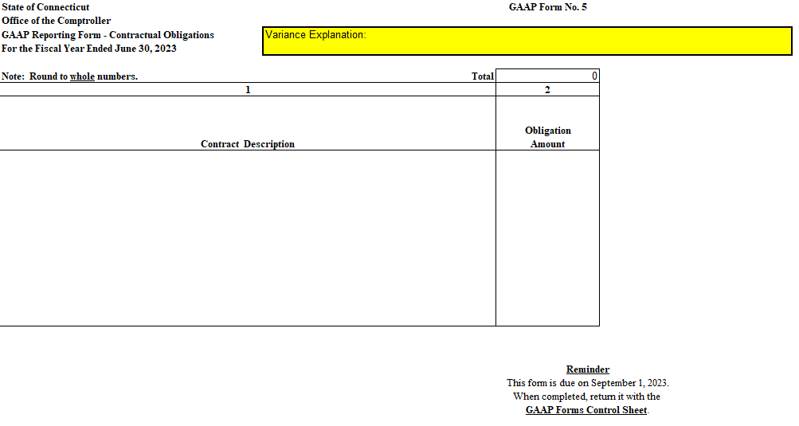
GAAP Form #5 Contractual Obligations

Slide 62
GAAP Form #5 Contractual Obligations

Slide 63
GAAP Form Training
GAAP form #5 Contractual Obligations
Examples/Cases
Unexpended Balance on Multi-year Contracts
Third Party Vendors and Non-employee personal service contracts

Slide 64
GAAP Form Training
GAAP form #5 Contractual Obligations
Examples/Cases
Case #1 GAAP Form 5 - Contractual Obligations
Your agency has contracts with several providers through personal of service agreements (PSA). The contracts run several years in term. It is not uncommon for the Department to amend its PSA contracts several times throughout the term of the contract. Contracts are usually amended with a retroactive date. One of your contracts is for a three-year term from 7/1/23 - 6/30/26 for $100,000 to be paid for each fiscal year. The $100,000 payments are made on the first date in the fiscal year. The Department reports $100,000 on GAAP Form 5 relative to obligations as of June 30, 2026. A similar contract with another provider for the same term but the Department amends the contract in August of 2026 adding another $100,000 per year to the contract with an effective date June 1, 2026, but the amendment is not signed off by the Department and the provider until the beginning of September 2026. The first $100,000 payment on this amendment was made two weeks later. What should the Department report as its contractual obligations as of June 30, 2026?
Continued

Slide 65
GAAP Form #5 Example
The case #1 answer is the agency should report the $400,000.
The reason is that in this example, as of June 30, 2026, the first payment on the original $300,000 contract was paid the previous July 1st the second payment is expected to be included in the 6/30/26 accrual of salaries and wages and the third payment is not due until fiscal year 2027. Additionally, the contract amendment became effective on June 1, 2026, but payments due are not expected to be processed in time to be included on the salary and wage accrual for fiscal 2026. Therefore, any payment due on the amended contract would not have occurred within a reasonable amount of time following the end of the fiscal year for the State to know that the amendment obligates the agency for the additional amount beyond the end of the fiscal year. Your agency would report $100,000 for the original contract and $300,000 for the amendment. GAAP form 5 is for capturing future obligations that exist at year-end for disclosure in the financial statement footnotes.

Slide 66
GAAP Form Training
GAAP form #5 Contractual Obligations
Examples/Cases
Case #2 GAAP Form 5 - Contractual obligations
Your agency had to consider these three contracts;
A contract dated 7/1/23-6/30/27 – (1 year remaining on the contract)
A contract dated 7/1/24-6/30/28 – (2 years remaining on the contract)
A contract dated 7/1/26-6/30/29 – (3 years remaining on the contract)
Which of the above would be included when reporting contractual obligations at FYE 26?

Slide 67
GAAP Form #5 Example
The case #2 answer is the agency should report only the first two contracts.
Contracts are excluded from form 5 when the effective "starting" date of the contract is beyond the date of the fiscal year end because the contract would not have been in existence at the end of fiscal year 6/30/26 for reporting purposes. Therefore, the 7/1/26 - 6/30/29 contract is excluded from being reported on GAAP form 5.

Slide 68
GAAP FORM # 5a
Instructions for completing the form and
Case Examples for preparation of Standard GAAP forms

Slide 69
GAAP Closing Package
GAAP form #5a – Contractual Retainage
The portion of the contract amount that is otherwise payable but is retained by the State pending its evaluation of acceptable performance by the contractor.

Slide 70
GAAP from #5a-Contractual Retainage
For purposes of this form, contractual retainages are defined as amounts owed by the State as of June 30th on outstanding contracts for which a stated percentage of the contract price has not been paid, pending final inspection or the lapse of a specified time period, or both.
This form applies to any contract outstanding as of June 30th that has a retainage amount greater than or equal to $300,000.
If your agency does not have any contracts to report, please check “form not applicable” on the GAAP Forms Control Sheet.

Slide 71
Instructions for GAAP form #5a
If your agency has any contracts that meet the above requirements,
please complete columns 1-5 of GAAP Form No. 5a as described below.
Enter required account coding for each contractual retainage amount (column 3)
Enter a description of the contract(s)
Enter the amount of the contractual retainage owed by the State as of June 30th
Enter the amount of the retainage as of June 30th (column 3) that was paid by your agency on or before August 31.
Note: For payments to be included in this column, supporting invoices must have receipt dates of June or prior months
Indicate whether or not the contract is funded by a Federal grant
Please compare last years’ amount to the current year amount to review the variance. If the variance is greater or less than five percent and five million dollars provide a brief explanation for the changes on the following form.

Slide 72
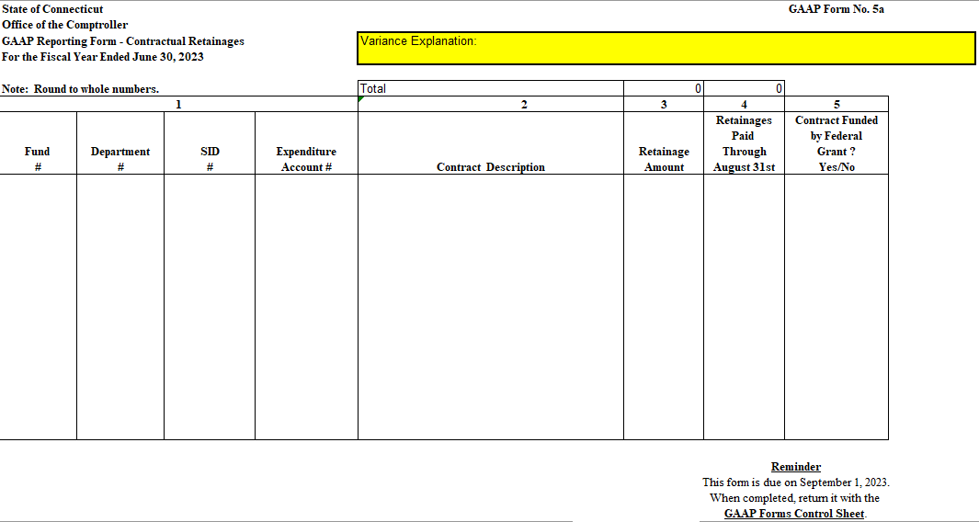
GAAP form #5a Contractual Retainage

Slide 73
GAAP Form Training
GAAP form #5a Contractual Retainage
Examples/Cases
Your agency has a contract outstanding at June 30, 2026. The contract is a $1.0 million computer consulting contract beginning July 1, 2015, and ending June 30, 2024. As of June 30, 2026, there were $60,000 in outstanding invoices, $370,000 in retainages, and payments totaling $520,000 relating to the contract. During July, retainage amounts paid were $10,000. Payments on this contract are recorded in fund number 13019, Department number OPM20000 and account number 55890. What are the reportable amounts for contractual retainage?

Slide 74
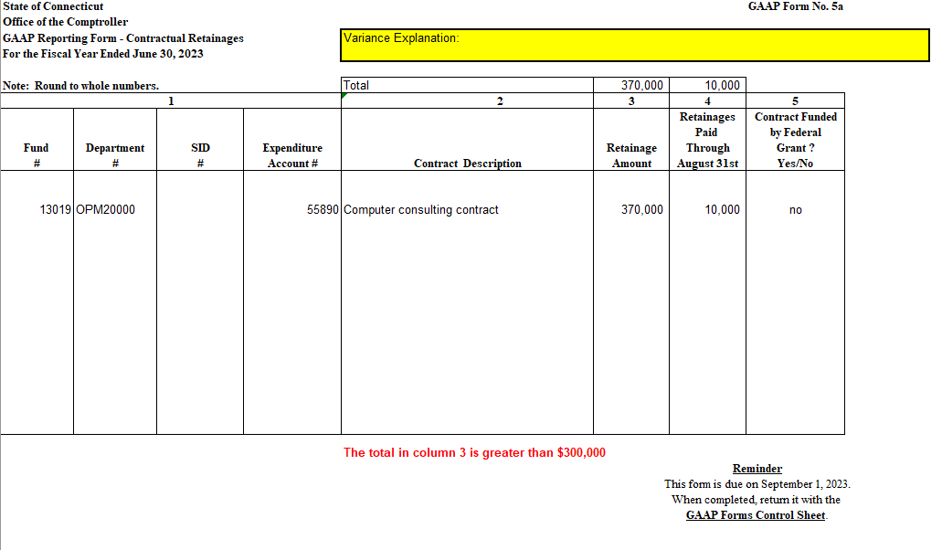
GAAP Form #5a Example

Slide 75
GAAP FORM # 7
Instructions for completing the form and
Case Examples for preparation of Standard GAAP forms

Slide 76
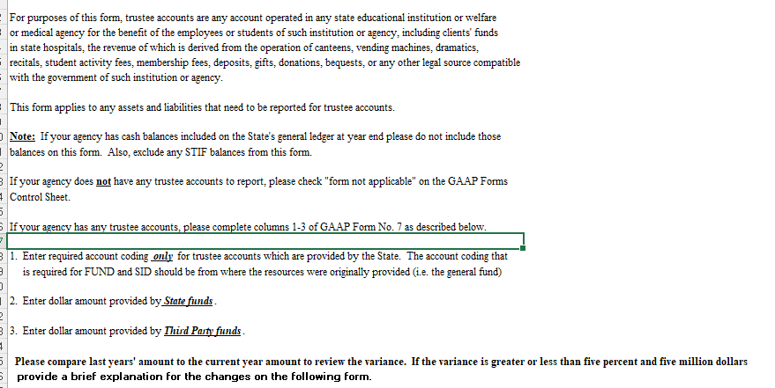
GAAP Form 7 Trustee Accounts

Slide 77
Instructions for GAAP form 7 Trustee Accounts
If your agency has any trustee accounts, please complete
columns 1-3 of GAAP Form No. 7 as described below.
Enter the type of account being reported
Enter required account coding only for trustee accounts which are provided by the State. The account coding that is required for FUND and SID should be from where the resources were originally provided (i.e. the general fund)
Enter dollar amount provided by State funds.
Enter dollar amount provided by Third Party funds.

Slide 78
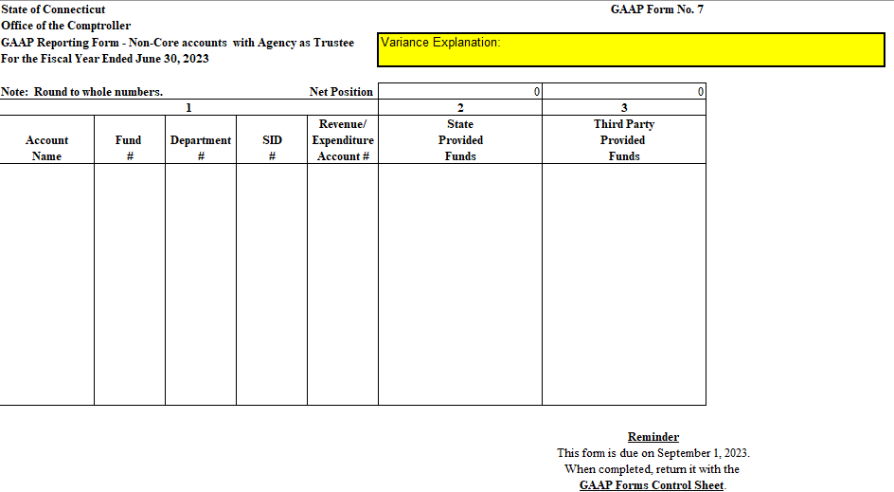
GAAP form #7 - Trustee Accounts

Slide 79
GAAP Form Training
GAAP form #7 Trustee Accounts
Case Example
Your agency has administrative responsibility for several trustee accounts totaling $500,000 some of which have NOT been recorded on the state’s general ledger. These accounts represent Client money management and “Rep Payee” type activities, while others include client activity STIF accounts in the custody of the Treasurer’s office and unexpended balances in your agency’s client activity checking accounts that were originally funded by appropriations from the State’s general fund.
Your records indicate that as of June 2026 there were receivables from clients of $1,000 and client payables of $500. The cash balances consist of $3,000 in client funds, $6,000 in Rep payee funds, $190,000 of money management funds, $200,000 in STIF accounts and $100,000 in unexpended balances of funds in an activity account that were originally provided last April from the following appropriations of the State’s general fund:
80% from 11000-DVA21000-10020-52742 and
20% from 11000-DVA21000-10020-54210
How would you report these trustee accounts using GAAP form #7?

Slide 80
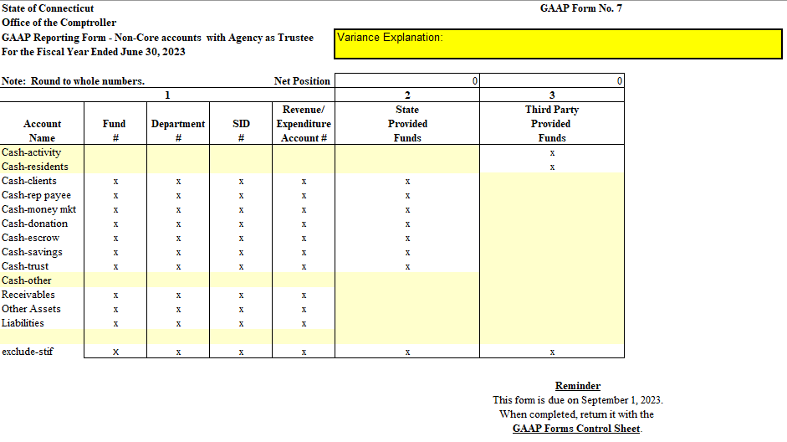
GAAP Form #7 Example

Slide 81
GAAP FORM # 8
Instructions for completing the form and
Case Examples for preparation of Standard GAAP forms

Slide 82
GAAP Form #8 – Other Assets
For purposes of this form, other assets are defined as any assets that your agency might have had as of June 30th that were not reported in the other GAAP forms or additional information.
This form does not apply to fixed assets (such as equipment or supplies inventory).
If your agency does not have other assets to report or if the total amount of other assets to be reported in column 3 is less than $300,000, please check “form not applicable” on GAAP Form Control Sheet.
If the total amount of other assets to be reported in column 3 is greater than or equal to $300,000, please complete columns 1-3 of GAAP Form No. 8 as follows:
1. Enter required account coding information for each asset amount (column 3).
2. Enter a description of the asset.
3. Enter the amount of the asset as of June 30th.
Please compare last years’ amount to the current year amount to review the variance. If the variance is greater or less tan five percent and five million dollars provide a brief explanation for the changes on the following form.

Slide 83
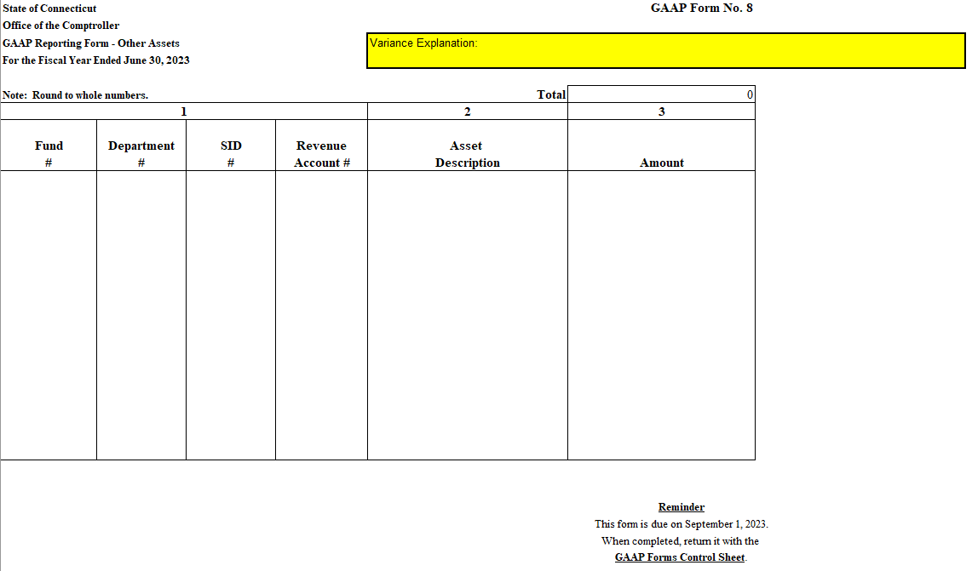
GAAP Form #8 – Other Assets

Slide 84
GAAP Form Training
GAAP Form #8 – Other Assets
Case examples
Agency records indicate your agency has $450,000 of prepaid postage not otherwise reportable on any other GAAP forms.
Postage expenditures for your agency are funded by the following appropriation:
11000-DSS60415-10020-14000-51764.

Slide 85
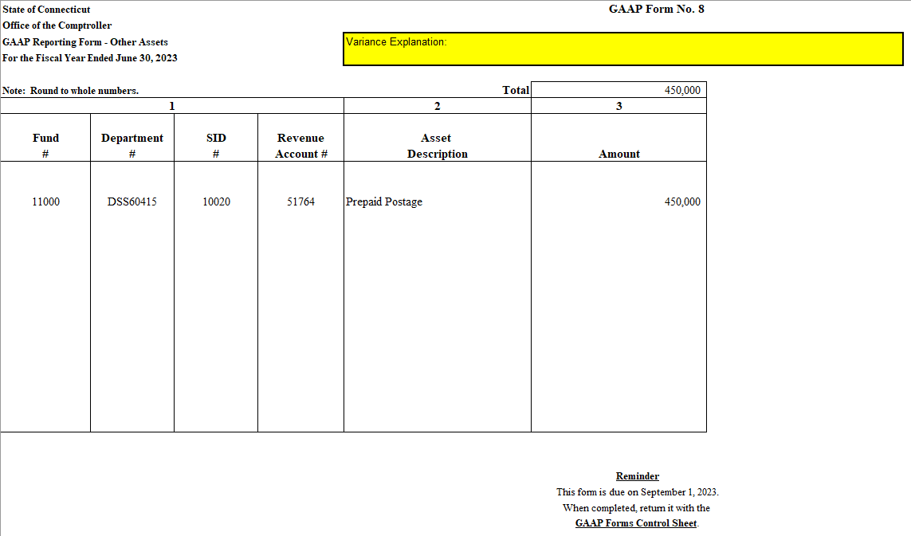
GAAP Form #8 Example

Slide 86
GAAP FORM # 9
Instructions for completing the form and
Case Examples for preparation of Standard GAAP forms

Slide 87
GAAP Form #9 – Other Liabilities
For purposes of this form, other liabilities are defined as any liabilities that your agency might have had as of June 30th and that were not reported in any other GAAP form or additional information.

Slide 88
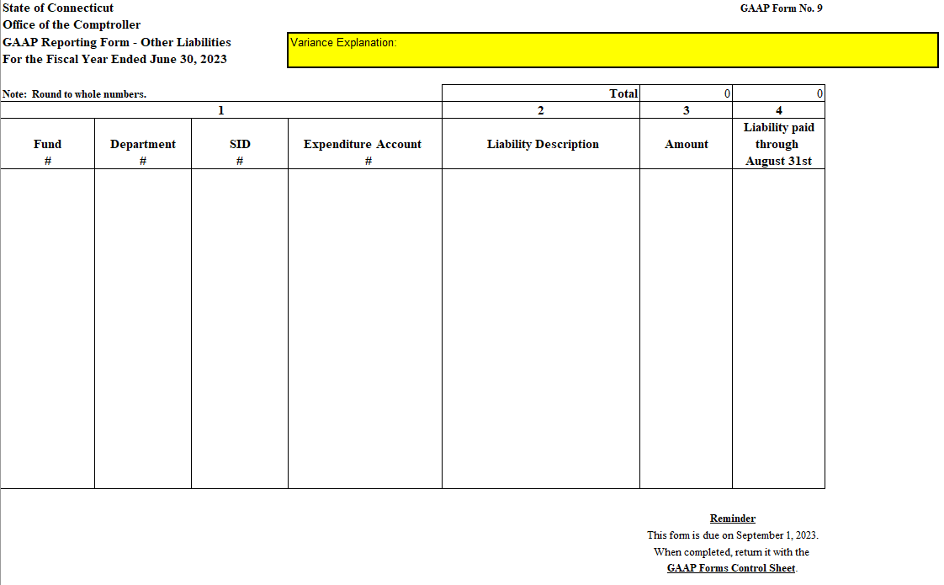
GAAP Form #9 Other Liabilities

Slide 89
Instructions for GAAP form #9
Do not report on this form unpaid vendor invoices as of June 30th which were paid on or before August 30th through Core-CT, having receipt dates of June or prior months.

Slide 90
Instructions for GAAP form #9
If your agency does not have other liabilities to report or if the total amount of other liabilities to be reported in column 3 is less than $300,000, please check “form not applicable” on GAAP Form Control Sheet.
If the total amount of other liabilities to be reported in column 3 is greater than or equal to $300,000, please complete columns 1-4 of GAAP Form No. 9 as follows:
Enter required account coding information for each liability amount (column 3).
Enter a description of the liability.
Enter the amount of the liability as of June 30th.
Enter the amount of the liability as of June 30th (column 3) that was paid by your agency on or before August 31st.
Note: For payments to be reported in this column, supporting invoices must have receipt dates of June or prior months.
Please compare last years’ amount to the current year amount to review the variance. If the variance is greater or less than five percent and five million dollars provide a brief explanation for the changes on the following form.

Slide 91
GAAP Form Training
GAAP Form #9 – Other Liabilities
Case examples
Your records indicate your agency, as of June 30, 2026, has administrative responsibility for implementation of a settlement agreement stemming from an accident involving State owned property and a private individual. The State has elected not to utilize its sovereign immunity protections even though it was self-insured in this case. Your understanding is that the settlement requires the State to pay $100,000 a year for three years beginning on the next accident anniversary date of May 1, 2027. The payments are funded by the following appropriation: 11000-OSC15910-12003-22003-51152.
Your agency has its own checking account & payment system that does not link with Core-CT. Every month your agency receives funding to facilitate child adoption and foster care services from appropriations of the general fund. The funding is regularly wired by the Treasurer’s office into an account set aside for your agency’s zero balance requirements. This account primarily funds “placement driven” payments to service providers, paid within two weeks of when the services were performed. Your understanding is the providers have earned $8 million of this money as of year-end which will be paid on the 15th of July via ACH wire transfer, all vouchers of which used new year accounting dates. The Treasurer's payment vouchers indicate the funding was paid using appropriation: 11000-DCF91147-16135-28050-52710. You therefore conclude the $8 million represents a liability to the service providers at June 30th that can only be reported via GAAP form #9.

Slide 92
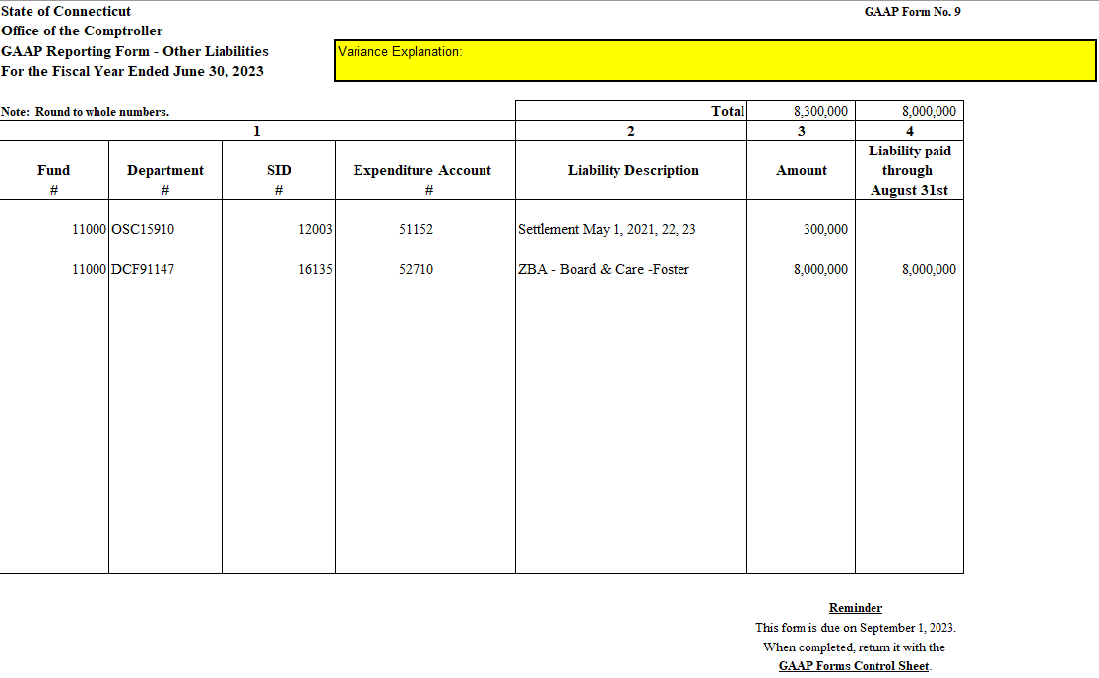
GAAP Form #9 – Other Liabilities

